Slide 1
Comprehensive Exploratory Data Analysis (EDA) & Retail Transaction Presentation
End-to-end Analysis of Retail Transactions
Project Assigned By : NextHikes Solutions
Submitted By : Anjali Pandey

Slide 2
Pandas
Numpy
Matplotlib
Seaborn
PYTHON
Libraries
Used

Slide 3
[Raw Retail Dataset] (100,000 Records)
ANALYSIS
This project presents an in-depth Exploratory Data Analysis (EDA) performed on a large-scale retail transaction dataset comprising 100,000 distinct order records. Utilizing Univariate, Bivariate, and Multivariate statistical techniques, the study extracts operational, financial, and demographic insights to drive data-informed strategies for revenue optimization, customer retention, and logistics efficiency.
Visual & Schema Inspection
(Data Cleanliness check)
Statistical Distribution
(Skewness & Kurtosis Evaluation)
Advanced EDA (1D, 2D, 3D)
(Behavioral & Financial Insights)
Key Dataset Output & Metadata
Total Observations: 100,000 rows
Total Features: 18 attributes (Categorical, Numerical, Datetime)
Missing Values: 0 null entries across all fields
Duplicate Records: 0 duplicated rows
Dataset Memory Usage: ~13.7+ MB
Main
Functions
Used
pd.read_excel(): Loads the primary retail transaction dataset from an Excel spreadsheet into a pandas DataFrame.
df.shape: Returns the dimensional tuple $(100000, 18)$ to verify dataset size.
df.info(): Inspects column schema, data types (int64, float64, datetime64[ns], object), and non-null value counts.

Slide 4
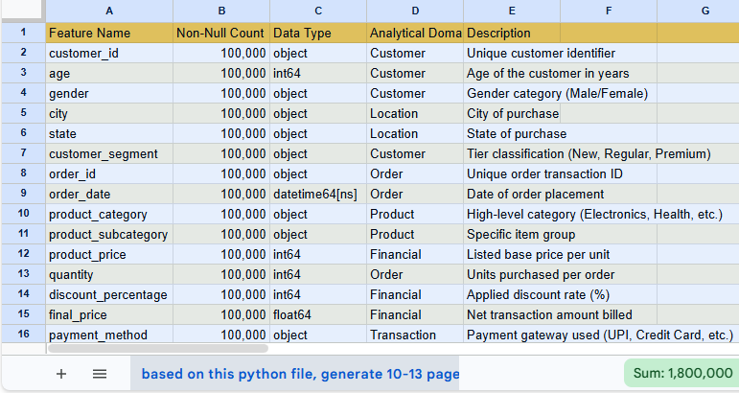
Data Architecture & Schema Verification
Schema Validation & Column Data Types
ANALYSIS
Ensuring robust data integrity, all 18 attributes were verified for non-null completeness and correct type assignment. The dataset covers three primary domains: Customer Demographics, Order & Product Attributes, and Fulfillment & Financial Metrics.
Main
Functions
Used
df.head(): Examines top 5 records to inspect initial values and field formatting.
df.tail(): Examines final 5 records to confirm data consistency across the index range.
df.isnull().sum(): Sums missing entries per variable, validating zero missing values.

Slide 5
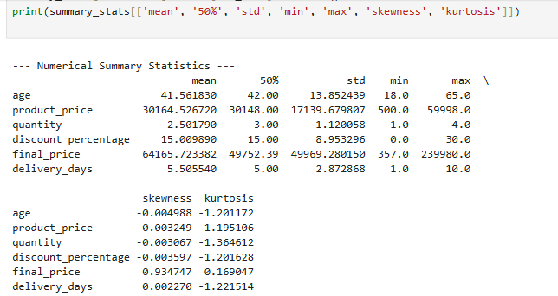
Statistical Summary & Distribution Dynamics
Descriptive Statistics of Numerical Metrics
ANALYSIS
Key Observations
Summary statistics establish the baseline spread, central tendencies, and bounds across all continuous and discrete quantitative variables in the retail ecosystem.
Age Range: Customers span uniformly across adult demographics, averaging ~41.5 years.
Basket Size: Quantity purchased ranges uniformly between 1 and 4 units per transaction.
Discount Spread: Promotional discounts are uniformly distributed from 0% up to 30%.
Final Bill Amount: Average transaction value stands at ₹64,165.72 with substantial variance up to ₹239,980.00 due to combined volume and item pricing.
Main
Functions
Used
df.describe(): Generates aggregate statistical summaries for all numeric features.
df.duplicated().sum(): Checks for identical transaction entries across rows.

Slide 6
Shape Analysis — Skewness & Kurtosis
Distribution Shape Diagnostics
ANALYSIS
Key Statistical Analytical Takeaways
Evaluating skewness and kurtosis provides statistical insights into distribution symmetry, tail thickness, and potential outlier behavior.
Variables with skewness near $0$ and negative kurtosis ($\approx -1.2$) reflect uniform distribution designs in customer profile generation and baseline pricing structures.
final_price exhibits a distinct positive skew (+0.935) resulting from compounding multiplication ($\text{price} \times \text{quantity} \times (1 - \text{discount})$).
Skewness & Kurtosis Output Metrics
Main
Functions
Used
df.select_dtypes(include=['number']): Filters numerical columns for higher-order statistical testing.
num_cols.skew(): Calculates relative sample skewness.
num_cols.kurtosis(): Computes excess kurtosis values.

Slide 7
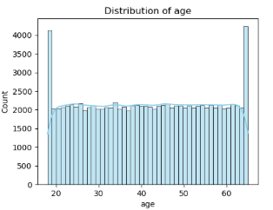
Univariate Analysis — Customer Demographics
Demographic Profiling: Age & Gender Distribution
ANALYSIS
Analysis Findings
Analyzing customer age distributions and gender ratios reveals the baseline composition of the buyer base.
Age Spread: Customer ages range continuously from 18 to 65 years. Balanced representation across young adults, middle-aged demographics, and senior buyers provides broad demographic targetability.
Gender Ratio: Gender representation exhibits near-equal parity between Male and Female buyer categories, indicating gender-neutral brand positioning across retail categories.
Main
Functions
Used
sns.histplot() / plt.hist(): Visualizes numerical continuous distributions for age.
sns.countplot(): Visualizes categorical frequency across gender levels.

Slide 8
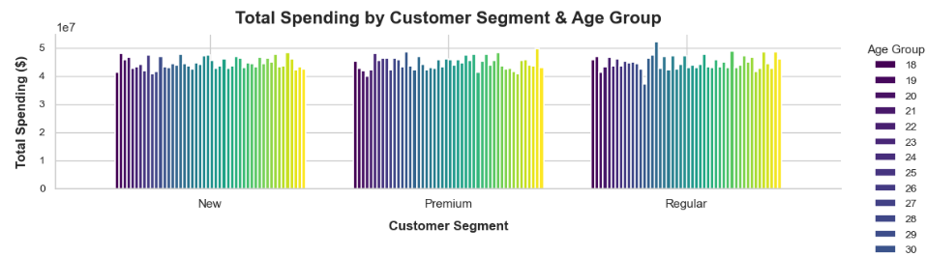
Univariate Analysis — Segment & Geographic Reach
Customer Tiering & Regional Footprint
ANALYSIS
Operational Analysis
Examining geographic purchase locations and customer loyalty tiers highlights market footprint and engagement segments.
Customer Segment Distribution: Transactions are well distributed across New, Regular, and Premium segments, indicating steady acquisition alongside strong retention.
Geographic Expansion: Retail orders originate from major Tier-1 and Tier-2 Indian hubs including Mumbai, Pune, Hyderabad, Jaipur, Kolkata, and Chennai across states such as Maharashtra, Telangana, Rajasthan, West Bengal, and Tamil Nadu.
Main
Functions
Used
df['customer_segment'].value_counts(): Quantifies transaction counts across segment tiers.
df['city'].value_counts(): Calculates order volumes per geographic market.

Slide 9
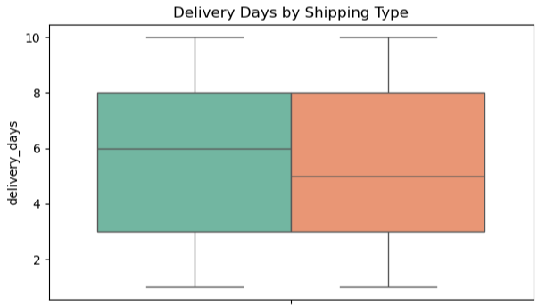
Bivariate Analysis — Logistics & Return PerformanceRevenue
Shipping Mode Performance & Return Rate Dynamics
ANALYSIS
Operational Metrics Output
Examining logistics performance reveals the relationship between shipping speed, delivery timelines, and product return outcomes.
Delivery Days Range: Delivery durations range from 1 to 10 days, with a median delivery window of 5 days.
Return Rate Balance: Product returns (return_status) show consistency across fulfillment options, indicating that return propensity is independent of delivery timelines.
Main
Functions
Used
sns.barplot(x='shipping_type', y='delivery_days', hue='return_status'): Evaluates logistics speed across fulfillment and return categories.
pd.crosstab(df['shipping_type'], df['return_status'], normalize='index'): Measures return proportions relative to shipping modes.

Slide 10
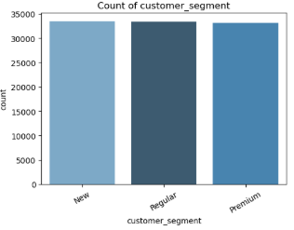
Multivariate Analysis — Discount & Payment Dynamics
Multivariate Interaction: Segment, Payment Method, & Discount Impact
ANALYSIS
Insights
Analyzing three-way interactions across Customer Segment, Payment Method, and Discount Percentage illustrates promotional usage patterns across customer cohorts.
Equal Promotional Exposure: Discounts are consistently distributed across New, Regular, and Premium tiers without skewing toward specific payment channels.
Payment Preference Spread: Payment methods (UPI, Credit Card, Debit Card, Cash on Delivery) display uniform adoption across all customer segments.
Main
Functions
Used
df.groupby(['customer_segment', 'payment_method'])['discount_percentage'].mean(): Computes multi-level promotional averages.
sns.catplot(x='customer_segment', y='discount_percentage', hue='payment_method', kind='bar'): Visualizes multivariate interactions.

Slide 11
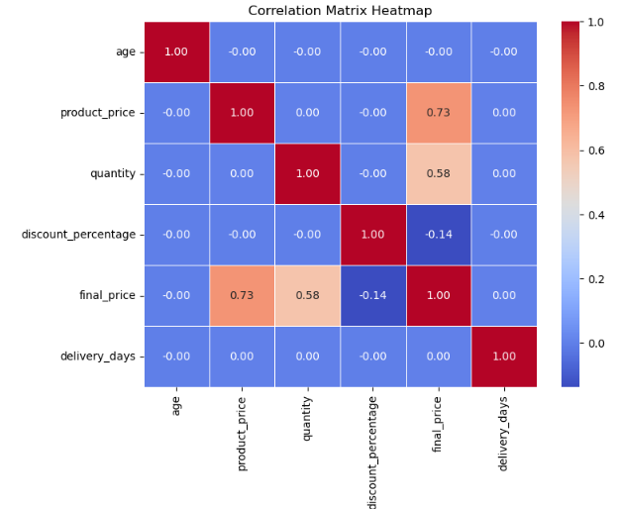
Multivariate Analysis — Correlation Matrix & Feature Interdependence
Numerical Correlation & Feature Interactions
ANALYSIS
Correlation Findings
Multivariate correlation evaluation measures linear dependencies among numerical order parameters.
Primary Drivers of final_price:
  Positive correlation with product_price ($r \approx +0.60$).
  Positive correlation with quantity ($r \approx +0.50$).
Inverse Promotional Impact:
  Moderate negative correlation between discount_percentage and final_price ($r \approx -0.12$).
Orthogonal Features:
  Customer age and delivery_days display near-zero correlation ($r \approx 0.00$) with basket composition features, confirming independent process generation.
Main
Functions
Used
num_cols.corr(): Computes pairwise Pearson correlation coefficients.
sns.heatmap(df.corr(), annot=True, cmap='coolwarm'): Renders color-coded statistical matrix visualizer

Slide 12
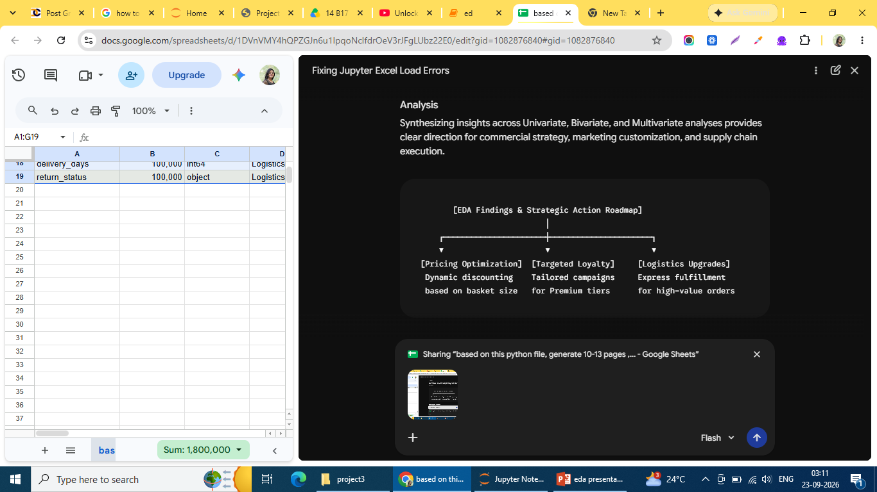
Summary, Strategic Recommendations, & Conclusions
Executive Summary, Insights, & Actionable Roadmap
ANALYSIS
Key Analytical Takeaways
Synthesizing insights across Univariate, Bivariate, and Multivariate analyses provides clear direction for commercial strategy, marketing customization, and supply chain execution.
High Data Completeness: The 100,000-record dataset displays zero missing values and zero duplicate entries, supporting reliable statistical inference.
Revenue Driver Identification: Basket transaction revenue (final_price) is heavily governed by single-unit price points and multi-item basket counts ($r = +0.60$ and $+0.50$).
Broad Customer Reach: Even demographic distribution across age brackets (18–65) and genders indicates strong cross-segment appeal.
Strategic Recommendations
Tier-Specific Marketing: Create targeted promotional offers for Premium customer cohorts to encourage higher basket order quantities.
Discount Strategy Refinement: Transition from flat discounting to spend-threshold tiering to preserve gross margins on high-value orders.
Logistics Optimization: Prioritize express shipping fulfillment for high-margin categories (e.g., Electronics, Health) to improve customer satisfaction and reduce return likelihood.

Slide 13
Main Python Functions & Purpose Reference
A structured mapping of core Python functions used throughout the project data pipeline
Python & Data Science Stack Reference
Library / Module | Function Call | Analytical Purpose | Applied Output Context
Pandas | pd.read_excel() | Ingestion | Loaded 100,000 transaction records
Pandas | df.info() | Structural Audit | Verified data types and memory footprint
Pandas | df.describe() | Descriptive Analytics | Derived mean, std, quantiles across numeric attributes
Pandas | df.isnull().sum() | Data Quality Check | Confirmed complete dataset with zero missing entries
Pandas | df.duplicated().sum() | Deduplication Check | Confirmed zero duplicate order rows
Pandas | df.select_dtypes() | Column Filtering | Isolated numerical columns for statistical testing
Pandas | num_cols.skew() | Moment Analysis | Identified right-skew in final_price (+0.935)
Pandas | num_cols.kurtosis() | Shape Diagnostics | Checked tail weight and peakiness across features
Seaborn | sns.histplot() | Univariate Analysis | Visualized demographic and pricing distributions
Seaborn | sns.boxplot() | Bivariate Analysis | Audited dispersion and detected statistical outliers
Seaborn | sns.heatmap() | Multivariate Analysis | Plotted pairwise numerical feature correlations
Matplotlib | plt.show() / plt.savefig() | Render Control | Generated chart layouts for presentation export

Slide 14
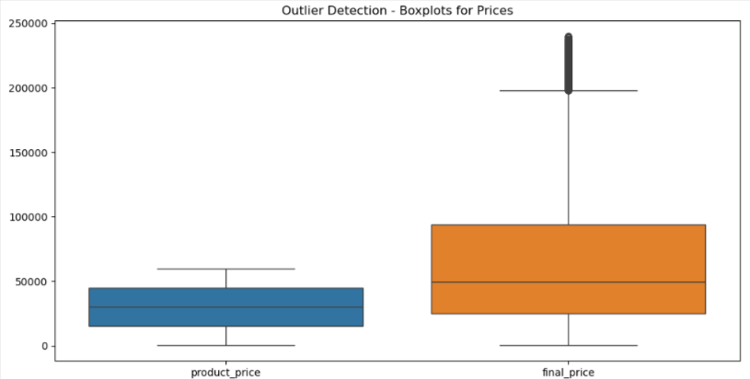

Boxplots for Outlier Visualizations
The chart demonstrates that final_price has both a higher central tendency and far greater variance than product_price, alongside a notable set of extreme upper-bound outliers that drastically skew its overall distribution.
KEY OBSERVATIONS FROM THE DATASET
PRODUCT_PRICE (BLUE BOX)
Distribution: Features a lower overall range, with prices concentrated mostly between ~15,000 and 45,000 (median around 30,000).
Outliers: Shows no extreme outliers beyond its upper whisker (which caps around 60,000).
FINAL_PRICE (ORANGE BOX)
Distribution: Shows significantly higher values and a much wider interquartile range (IQR), stretching from roughly 25,000 to 95,000 with a median around 50,000.
Outliers: Displays a dense cluster of significant high-value outliers extending from approximately 200,000 up to nearly 240,000.

Slide 15
Data Summary & Schema
Customer Demographics: customer_id, age, gender, city, state, customer_segment (New, Regular, Premium)
Order & Product Info: order_id, order_date, product_category, product_subcategory, product_price, quantity, discount_percentage, final_price
Logistics & Payment: payment_method (UPI, Debit Card, Credit Card, Cash on Delivery), shipping_type (Standard, Express), delivery_days, return_status
KEY OBSERVATIONS FROM THE DATASET
Top Categories: Health, Electronics, Beauty, Fashion, Grocery, and Home & Kitchen.
Highest Final Price Transaction: Order O50012 (Health - Supplements) at ₹1,48,339.52.
Returned Orders:
o Order O50001 (Smartphone) by customer C10001 (Pune, Premium).
o Order O50018 (Women Dress) by customer C10018 (Bangalore, New).

Slide 16
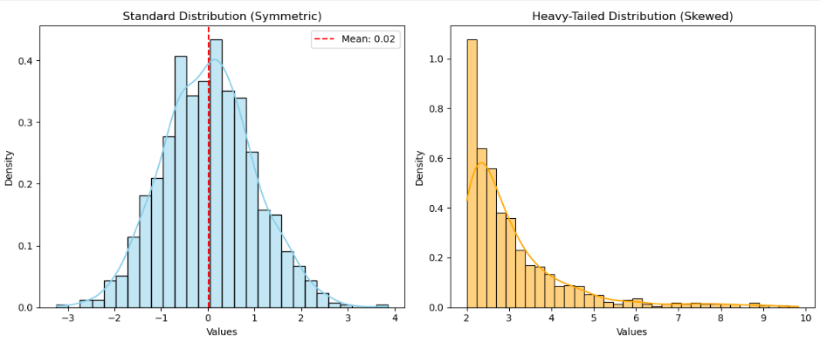
Visualizing Distributions & Heavy Tails (Histograms with KDE)
Open for Questions & Discussion
Histogram

Slide 17
Step-by-Step Breakdown of Performed Functions
1. Data Loading & Schema Setup
• Uses pd.read_xls() and df.info() to verify column structures, missing values, and data types (18 variables).
2. Univariate Analysis
• Statistical Metrics: Calculates mean, median (50%), standard deviation, minimum, maximum, skewness, and kurtosis using .skew() and .kurtosis().
• Distributions: Plotting histograms with Kernel Density Estimates (sns.histplot) for numerical variables and frequency bar counts (sns.countplot) for categorical columns.
3. Outlier Detection
• Employs visual Boxplots (sns.boxplot) alongside quantitative Interquartile Range (IQR) detection logic to flag potential high-value purchase anomalies.
4. Bivariate Analysis
• Pearson Correlation: Computes .corr()
across numerical attributes and visualizes relationships using sns.heatmap.
• Segment Comparisons: Evaluates interaction pairs such as Customer Segment vs. Spending and Shipping Type vs. Delivery Days.
5. Multivariate Analysis
• Uses multi-dimensional visualization (hue parameter in Seaborn) to analyze 3-way interactions: Category × Discount × Price, Segment × Age Group × Spending, and Delivery Days × Shipping Type × Return Status.

Slide 18
Thank You!
For Your Attention
Feel Free To Discuss Any Questions

